Slide 1

Sample-sequence-interpretation pipeline

Slide 2
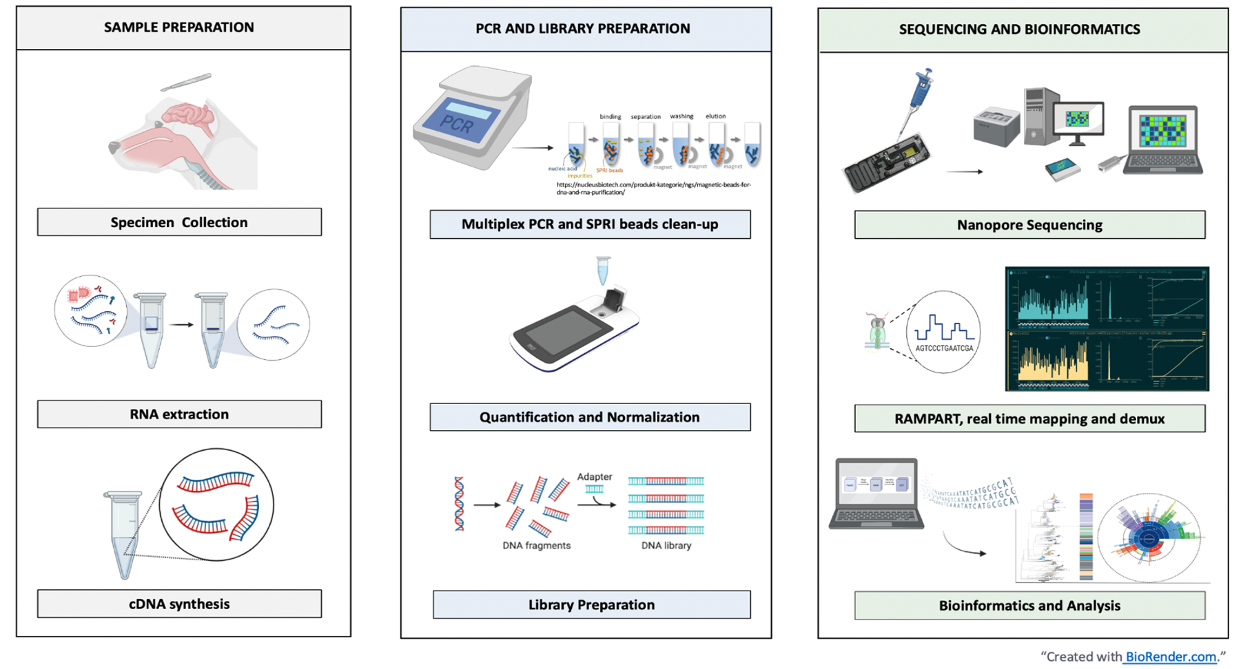
Sample-sequence-interpretation workflow
Bautista et al (in press), JoVE
Notes:
Add JOVE reference: Bautista et al (in press), JoVE

Slide 3
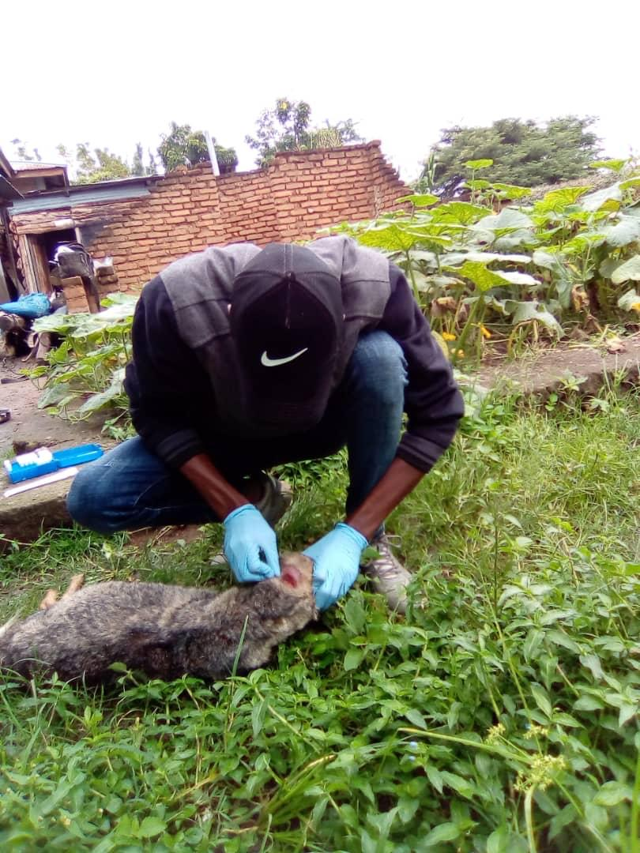
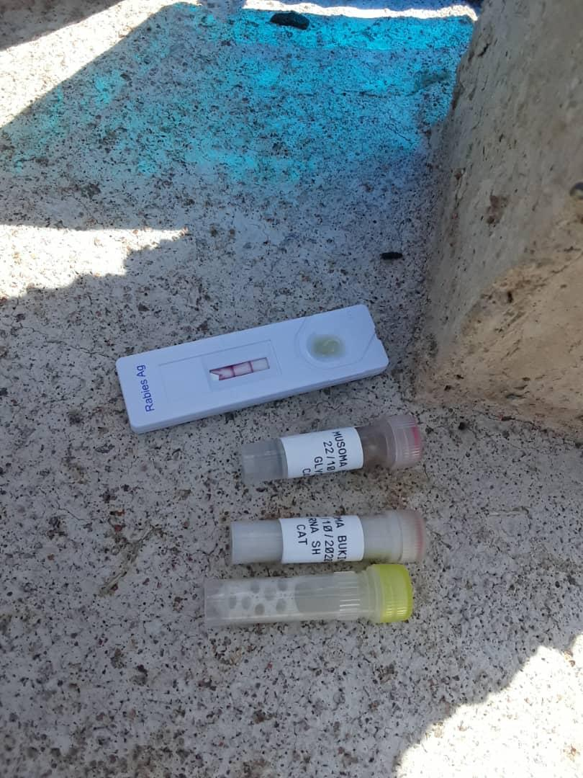
Sample Preparation
Sample collection (brain sample) +
rapid test is performed in the field
Biosafety Requirements
Pre-Exposure Prophylaxis
Proper PPE
Proper disposal of dog’s head

Slide 4
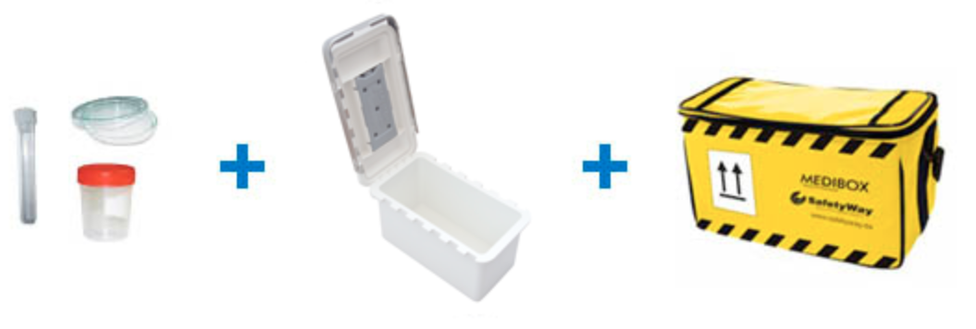
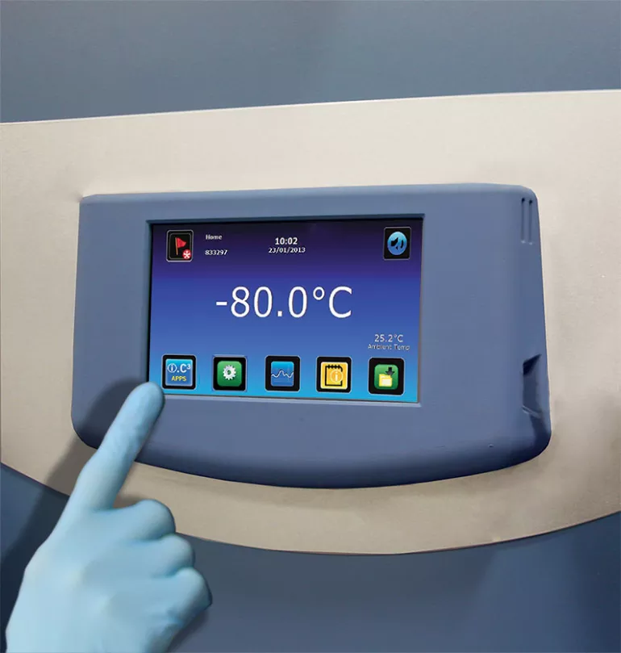
Sample Preparation
Sample Quality Check
Use RNA stabilization/ preservation buffer
Ensure good quality samples
Properly labelled samples
Triple packaging system
Good transport conditions: at least 4℃
Sample storage
Ultra low Freezer -70 / -80
Sample in RNA shield - room temp for months
Notes:
Biosafety Requirements
Pre-Exposure Prophylaxis - complete vaccination and Ab titer checked
Proper PPE - gloves, mask, goggles, disposable labgown
Proper disposal of dog’s head - disinfectant, autoclave bag, autoclave
Sample Quality Check
Use RNA stabilization/ preservation buffer
Ensure good quality samples
Ensure good transport conditions: properly labelled samples
Sample storage:
we know freeze/thaw is common due to power issues in lmics RNA buffer helps
Can store in RNA shield at room temp for month (helps if storage facility is far from field collection)
RNA ideally in -70/80

Slide 5
RNA extraction - cDNA extraction

Slide 6
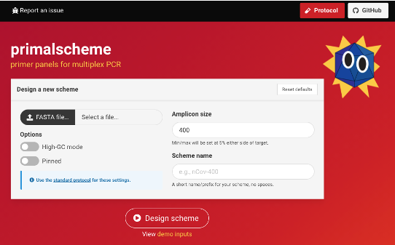
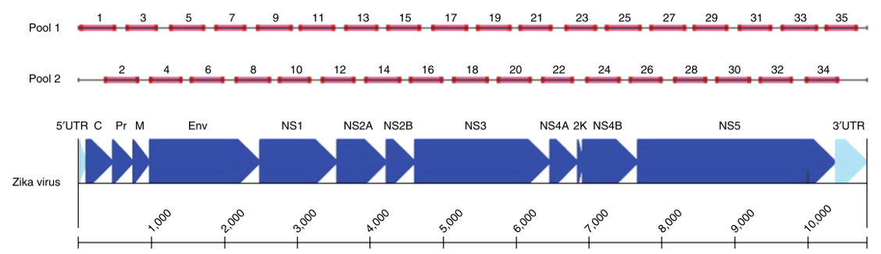
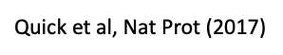
Multiplex PCR
Multiplex tiling PCR approach
References: From Genbank, East Africa/Peru/Philippines/Nigeria/Malawi rabies virus WGS
Short fragments(~400bp)
Initially developed for Zika sequencing (high Ct clinical samples)
Generates tiling amplicons for near complete genome coverage
400bp

Slide 7
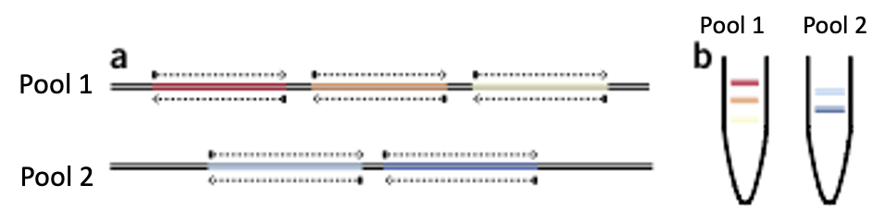
Multiplex PCR
•Q5® Hot Start High-Fidelity DNA Polymerase
Must be used, other polymerase won’t work
Has a higher Tm than other polymerases
•Mastermix contains all PCR components
Just combine with cDNA and water
•Require 2 reactions per sample:
Pool A and Pool B

Slide 8
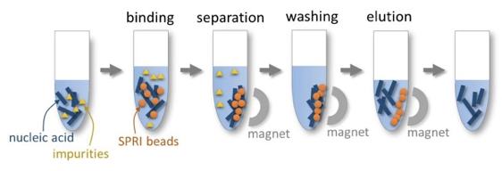
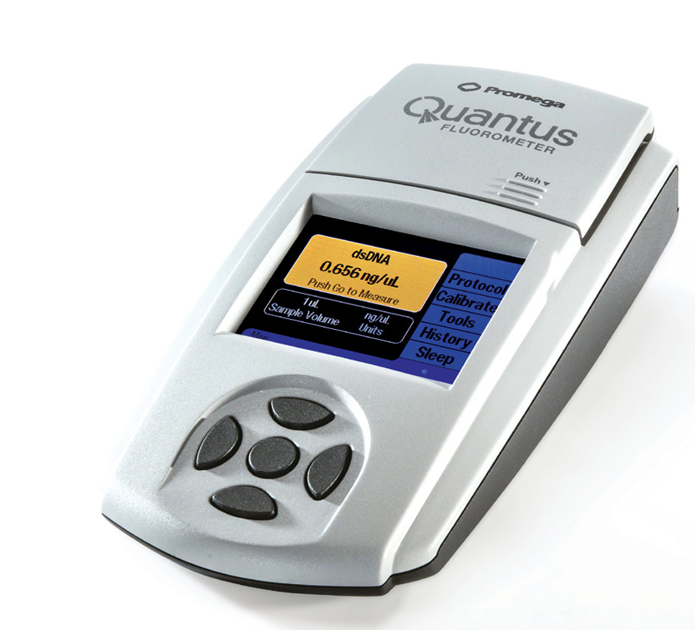
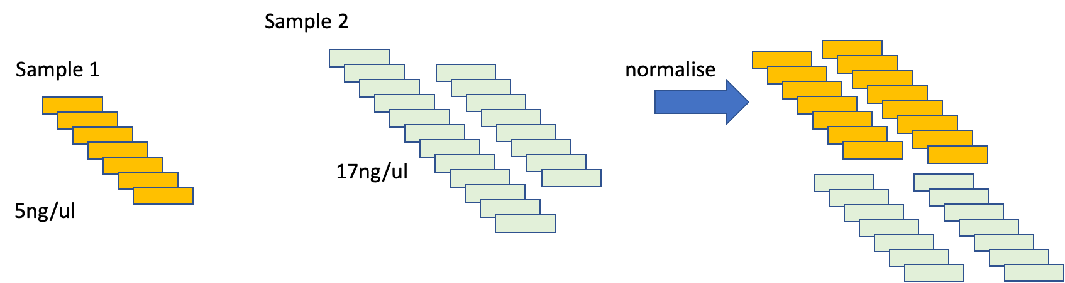
SPRI Beads Clean-up, Quantification & Normalisation
•SPRI – Solid Phase Reversible Immobilisation
•Quantification using fluorometer
•Variation between samples
•Normalisation to even the sequencing coverage across samples
Notes:
•Used Solid phase reversible immobilization (SPRI) beads (Branded as e.g. Ampure XP, PCRClean dx)
•Have a surface that selectively binds DNA
•Bound DNA can then be easily separated from the aqueous phase with a magnet and impurities discarded
•Washing twice with 80% ethanol then the DNA eluted by adding water
•Can also perform size selection by altering buffer concentration ratio

Slide 9
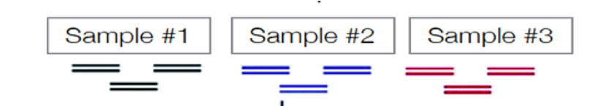
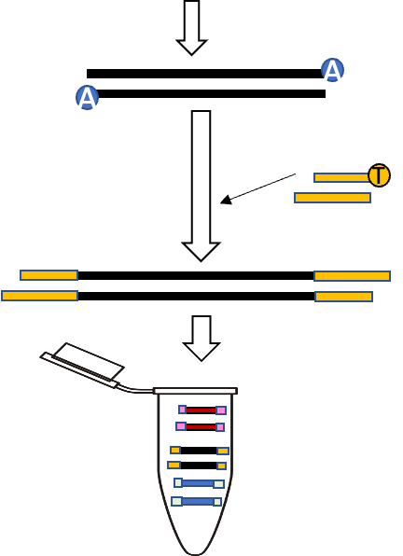
Library preparation
to dsDNA
1.End repair/dA tailing
- Add a 3’-dA tail to dsDNA
2. Barcoding and barcode ligation
3. Pool together barcoded DNA
4. Clean-up with SPRI beads
5. Quantify with Quantus Fluorometer
6. Adaptor Ligation
•In order to multiplex samples on one run, we need to BARCODE
Notes:
Slide is too busy and hard to see
REmove the middle one, it’s not entirely correct for the protocol and could confuse (we don’t do FFPE repair or fragmentation, and we use amplicons). If you are trying to show and explain ligation steps then find a better image or modify/crop this one.

Slide 10
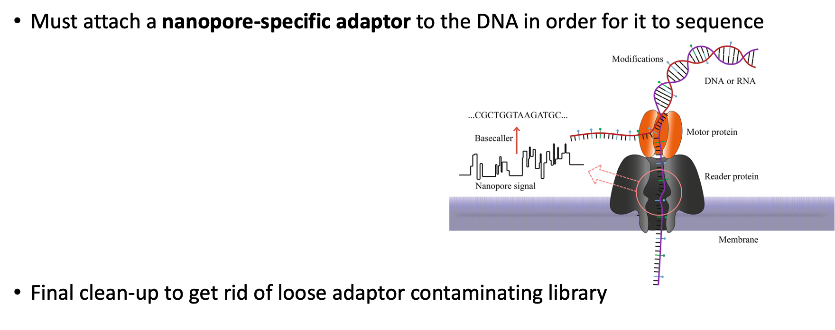
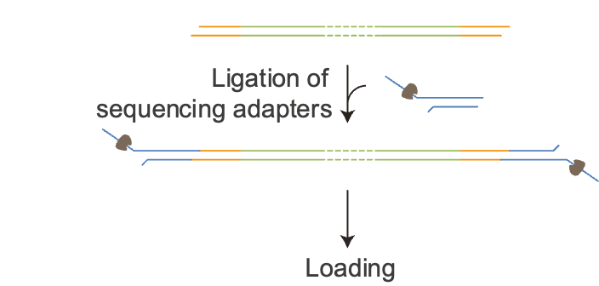
Adaptor Ligation

Slide 11
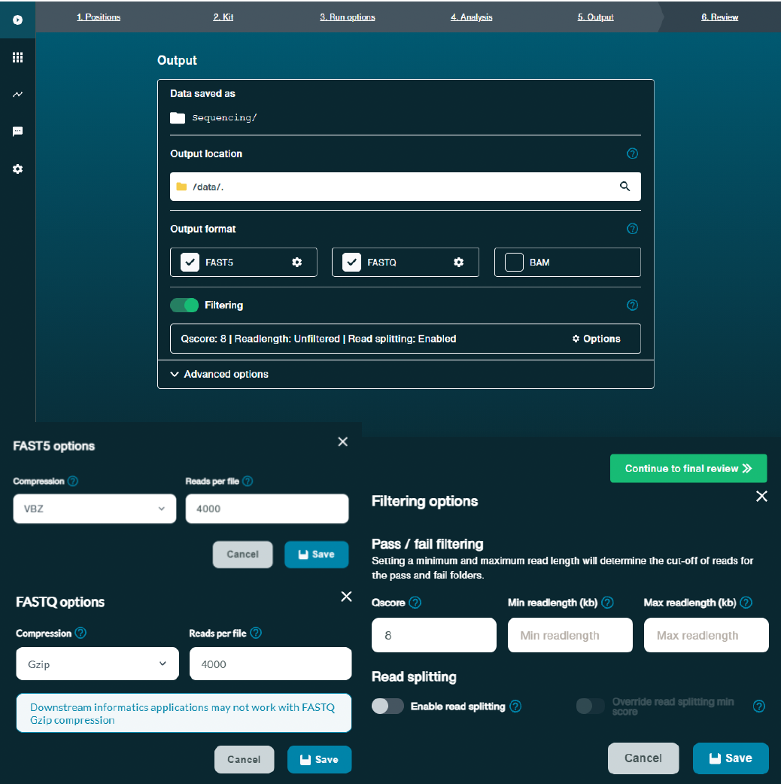
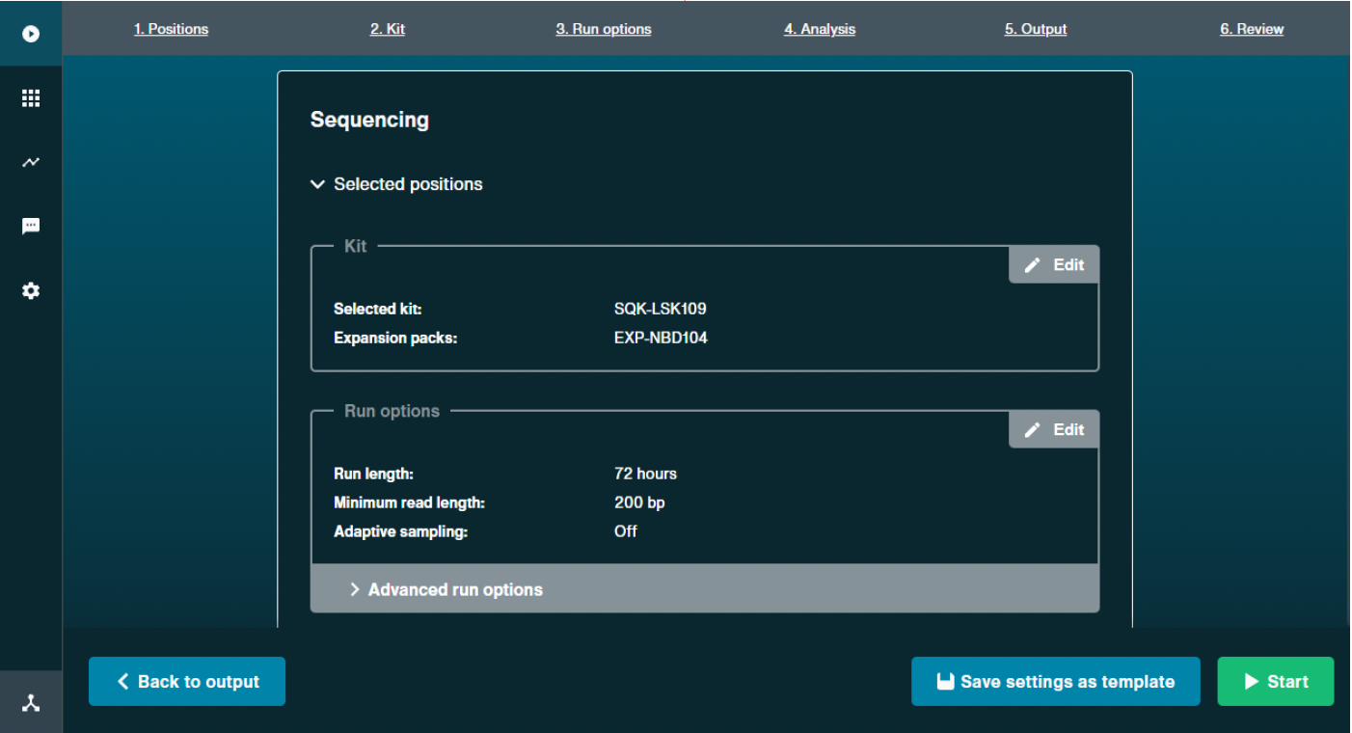
Sequencing: Minknow and RAMPART interpretation - to be shown during the actual run
Notes:
Image is stretched and too small for slide… LAZY
Explain that minknow is the nanopore sequencing software, is a GUI to allow you to monitor and qc run in certain ways

Slide 12
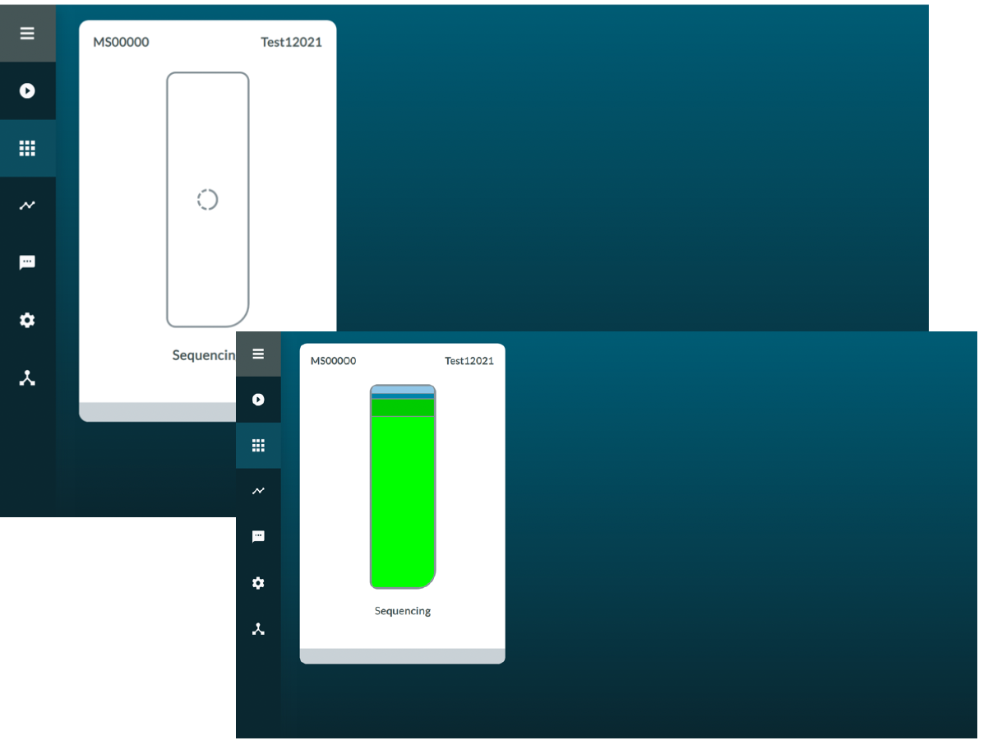
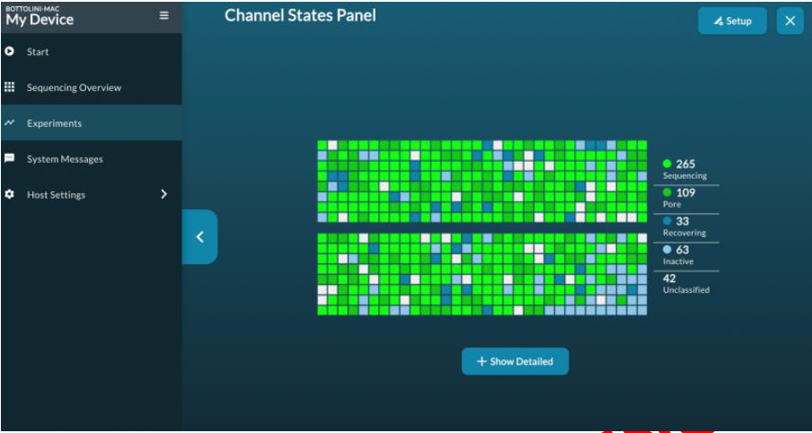
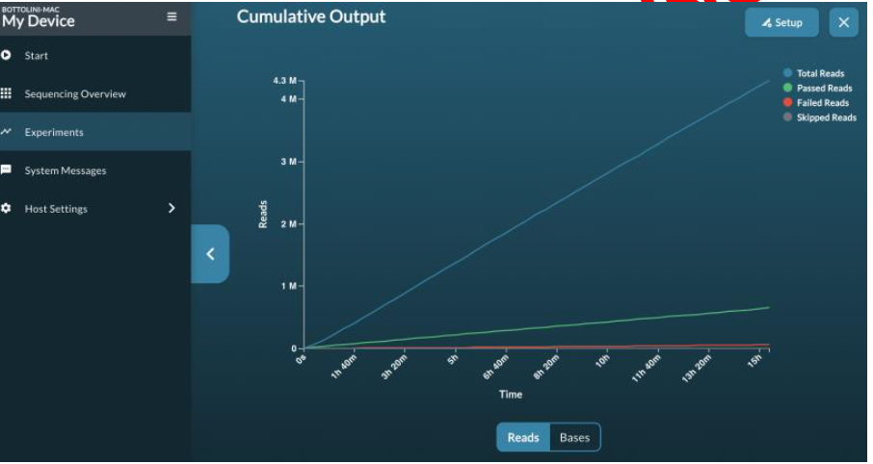
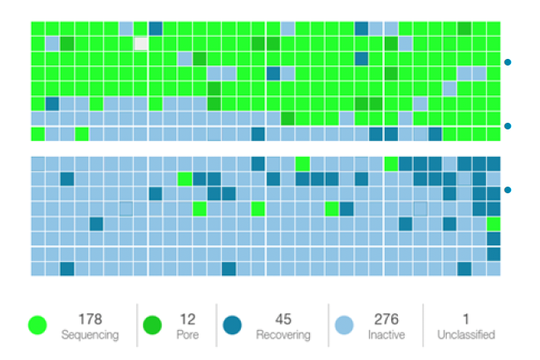
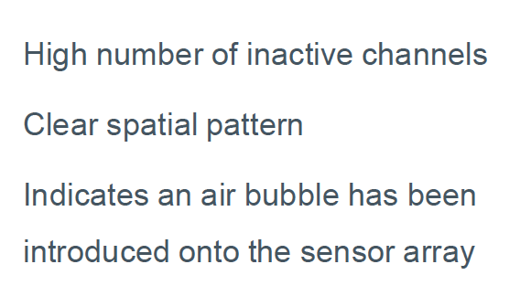
Sequencing: Minknow and RAMPART interpretation - to be shown during the actual run

Slide 13
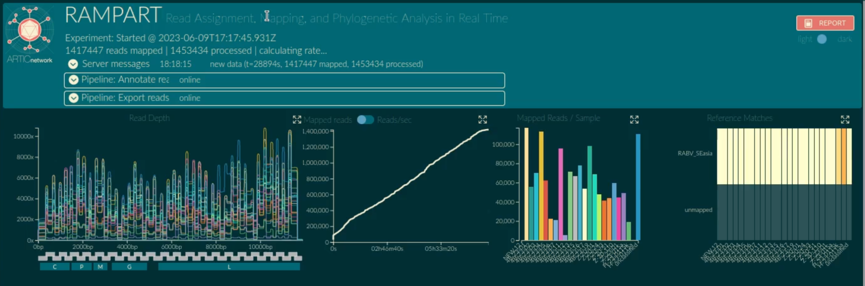
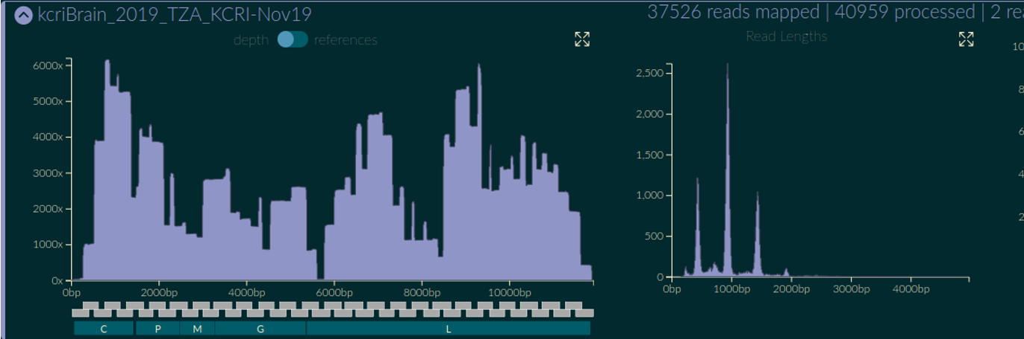
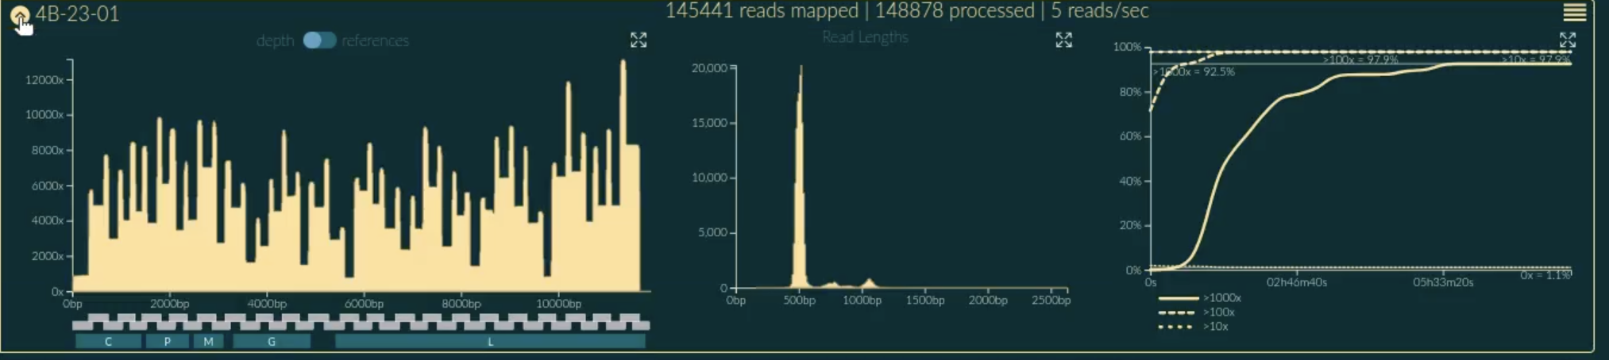
Sequencing: Minknow and RAMPART interpretation - to be shown during the actual run

Slide 14
Consensus generation
Artic-rabv pipeline
Demultiplexing
Read Filtering
Medaka consensus pipeline
Notes:
Is this unfinished?

Slide 15
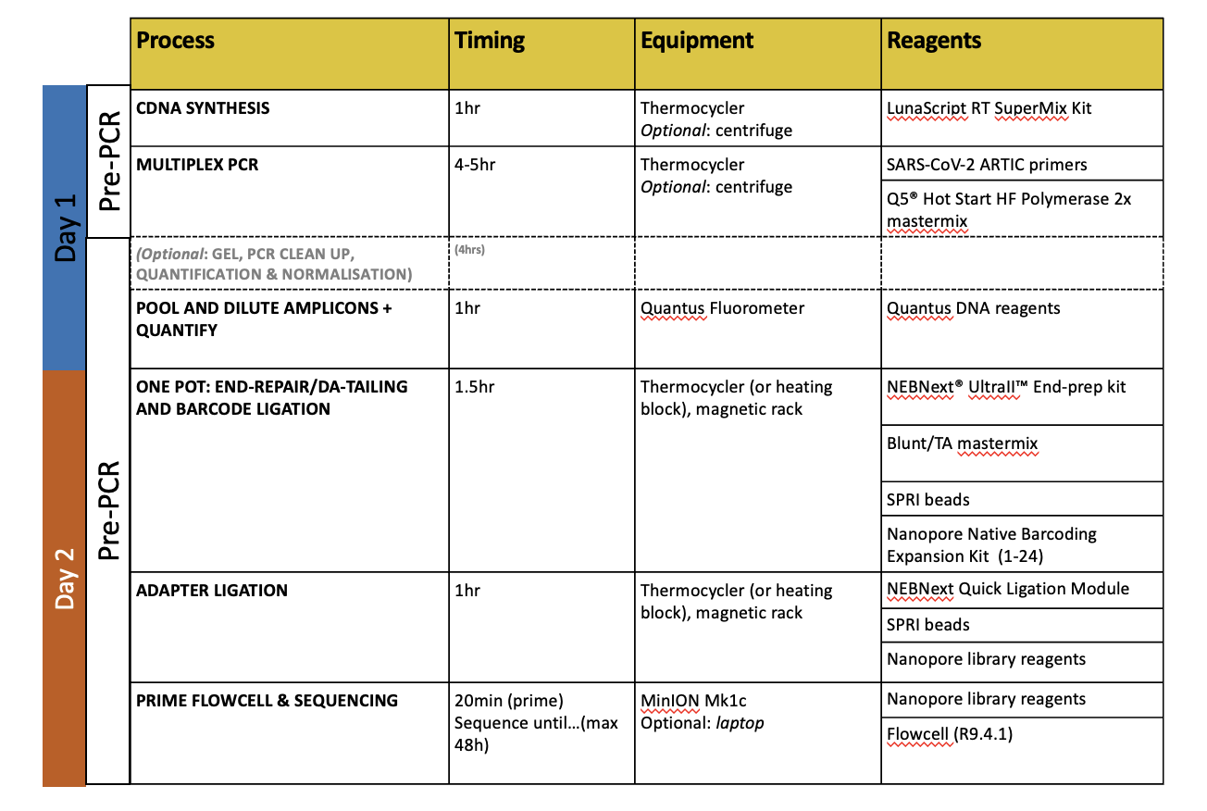
Summary
Pause point
Pause point
Notes:
Puase points in the protocol : Day 1, Day 2 after adapter ligation

Slide 16
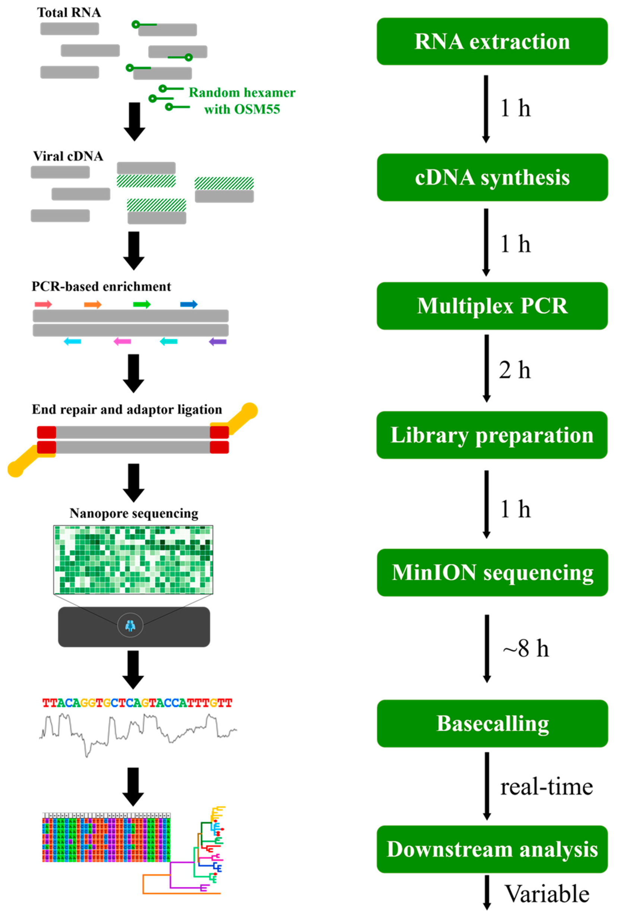
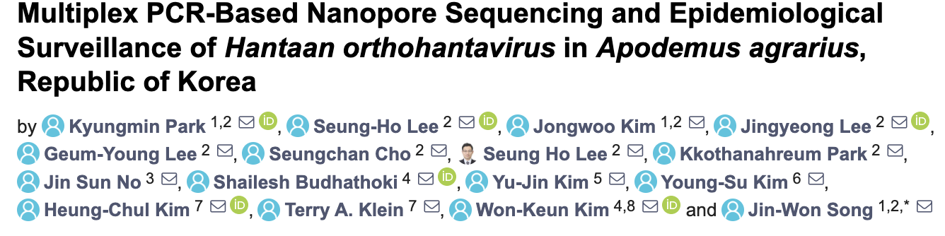
Summary
Notes:
TOO BUSY!
Way too much on this slide, I don’t know what you are attempting here

Slide 17
Your advice on how to fit protocol into working day
We have three are pause points in protocol to allow breaks!
Take your time before and when doing the sequencing work - make sure you have all what is needed
You can do this work in two days, not so intense
Think what you want at the end of the project

Slide 18





#UofGWorldChangers
@UofGlasgow

